Slide 1

Database Systems and Web (15B11CI312)

Slide 2
Database Systems and Web
Lecture 3

Slide 3
Contents to be covered
Entity-Relationship (E-R) Model
Entity and Its Attributes
Types of Attributes
Domain of Attributes
Entity types and Entity sets
Classification of Constraints
Keys

Slide 4
Entity-Relationship (E-R) Model
The ER Model of data is the most widely as conceptual level data model.
 Data model to describe the database system at the requirements collection stage.
Defines high level description.
Very easy to understand.

Slide 5
Entity-Relationship (E-R) Model
Main concept of ER model:
Diagrammatic notation of Entities, attributes of entities and relationships between entities.
Entity-Relationship (E-R) Diagram
A detailed, logical representation of the entities, associations and data elements for an organization or business. Diagrammatic notation associated with the ER model, known as ER diagrams.

Slide 6
Entity
Entity : An entity may be an object with a physical or conceptual existence.
For example :
particular person, car, house, company etc.
In the context of University database, an individual student, faculty member, a class room and a course are entities.
An Entity is denoted by rectangle with entity name
Student

Slide 7
Attributes
Each entity is described by a set of attributes/properties.
For example : Attributes of student entity
 SName – name of the student.
 RNumber – the roll number of the student.
 Gender – the gender of the student etc.
Attribute are denoted by ellipse
Student
SName
RNumber
Gender

Slide 8
Types of Attributes
Simple Attributes
An attribute having atomic or indivisible values.
For example: RNumber
Gender
Student
SName
RNumber
Gender

Slide 9
Types of Attributes
Composite Attributes
Attributes having several components in the value.
For Example: Student Name
Student Address
College Address
Composite Attribute is represented as a tree like structure
Student
SName
RNumber
Gender
First
Name
Middle Name
Last
Name

Slide 10
Types of Attributes
Derived Attributes
The value of an attribute is dependents on some other attribute.
example: Age depends on DateOf Birth, so age can be a derived attribute.
Derived attributes are represented by dashed ellipse
Student
Age
DOB
SName
RNumber
Gender

Slide 11
Types of Attributes
Multi-valued
 Attribute having a set of values rather than a single value.
For Example : Courses Enrolled attribute for student
Mobile Number attribute for student
Previous Degree attribute for student.
Student
Age
MNumber
DOB
SName
RNumber
Gender

Slide 12
Domains of Attributes
Each attribute takes values from a set called its domain
For Example: StudentAge – {17,18, …, 55}
HomeAddress – character strings of length 35
Domain of composite attributes –
cross product of domains of component attributes
Domain of multi-valued attributes –
set of subsets of values from the basic domain

Slide 13
E-R Diagram With Composite, Multivalued, and Derived Attributes
block
City
State
PIN
Address
Student
Age
MNumber
DOB
SName
RNumber
Gender

Slide 14
Classification of Constraints
Keys
Single-value constraints
Multi-valued constraints
Mapping Cardinalities and Participation Constraints

Slide 15
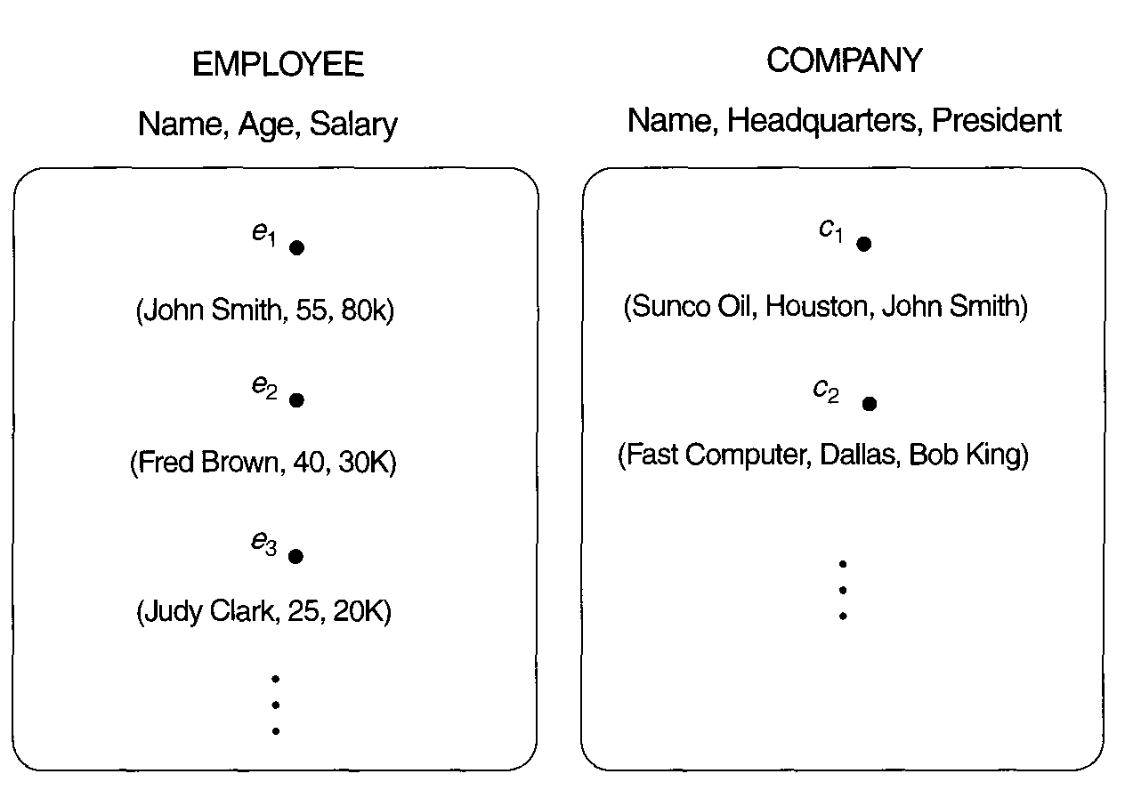
Entity Type and Entity Sets
An entity type defines a collection (or set) of entities that have the same attributes. Each entity type in the database is described by its name and attributes.
The collection of all entities of a particular entity type in the database at any point in time is called an entity set.
Reading Suggestion and image source : Elmasri and Navathe , ” FUNDAMENTALS OF DATABASE SYSTEMS”

Slide 16
Key Attributes
Key – an attribute or a collection of attributes whose value(s) uniquely identify an entity in the entity set.
For Example:
• Enrollment Number- Key for Student entity set
• EmpID - Key for Faculty entity set

Slide 17
Key Attributes
A key for an entity set may have more than one attribute.
For Example :
HostelName, RoomNo - Key for Student entity set
(assuming that each student gets to stay in a single room)
An entity set may have more than one key.
For Example :
Enrollment number, aadhar card number, voter id number
Keys can be determined only from the meaning of the attributes in the entity type and Determined by the designers

Slide 18
Keys
Super Key – An attribute or a combination of attribute that is used to identify the records uniquely is known as Super Key.
A table can have many Super Keys.
Example of Super Key for given schema
1 En_Number 2 Aadhar_ID
3 En_Number, Name 4 Aadhar_ID, Name
5 En_Number, Address 6 Name, Address
7 Name, Address, CGPA …………
So on as any combination which can identify the records uniquely will be a Super Key.
En_Number | Aadhar_ID | Name | CGPA | Address

Slide 19
Keys
Candidate Key – It can be defined as minimal Super Key or irreducible Super Key
For example
En_Number : is a Candidate Key
Aadhar_ID : is a Candidate Key
Name, Address : is a Candidate Key
Combination of “Name and Address” can identify the record uniquely, but neither Name nor Address can be used to identify the records uniquely as it might be possible that we have two employees with similar name or two employees from the same house.
En_Number,Aadhar_ID: is not a Candidate Key
En_Number,Name: is not a Candidate Key
En_Number | Aadhar_ID | Name | CGPA | Address

Slide 20
Keys
Primary Key – A Candidate Key that is used for unique identification of each row in a table is known as Primary Key. A Primary Key can consist of one or more attributes of a table.
Several candidate keys may exist, one of the candidate keys is selected to be the primary key. Database designer can use one of the Candidate Key as a Primary Key.
For Example
1. En_Number
2. Aadhar_ID
3.Name,Address
En_Number | Aadhar_ID | Name | CGPA | Address
Note:. In this example we have “En_Number”, “Aadhar_ID” and “Name, Address” as Candidate Key. A good database designer will consider “En_Number” or “Aadhar_ID” Key as a Primary Key as the other key is the combination of more than one attribute.

Slide 21
Keys
Alternate Key – Alternate Key can be any of the Candidate Keys except for the Primary Key.
For example :
Suppose database designer has consider “En_Number” as primary key , Then remaining Candidate Keys “Aadhar_ID” and “Name, Address” will treat as Alternate Key
Composite Key – There may be no single attribute which can be treat as key, in this case we use multiple attributes to create a Primary Key then that Primary Key is called Composite Key (also called a Compound Key or Concatenated Key).
For Example :
Assume “En_Number” and “Aadhar_ID” are not the part of given schema . In this case we will use “Name, Address” as a Primary Key and then it will be our Composite Key.
En_Number | Aadhar_ID | Name | CGPA | Address

Slide 22
Keys
Foreign Key – A foreign key is an attribute or combination of attribute in one base table that points to the candidate key (generally it is the primary key) of another table. The purpose of the foreign key is to ensure referential integrity of the data i.e. only values that are supposed to appear in the database are permitted.
.

Slide 23
Keys
For Example – Consider given two tables i.e. Student Table and Department Table where RNumber and Dept are Primary Keys.
Now the “Branch” attribute of Student Table (dependent or child table) can be defined as the Foreign Key as it can reference to the “Dept” attribute of the Departments table (the referenced or parent table).
A Foreign Key value must match an existing value in the parent table or be NULL.
A Foreign Key must primary key of unique key in parent table.
RNumber | Sname | CGPA | Branch
1 | A | 7 | CSE
2 | B | 8 | ECE
3 | C | 6 | CSE
4 | D | 9 | BT
Dept | HOD
CSE | X
ECE | Y
BT | Z

Slide 24
Primary Keys in E/R Diagrams
Every entity set must have a primary key
Denoted by the underline attribute
Student
Age
MNumber
DOB
SName
RNumber
Gender

